Slide 1


C Programing
Prof. John Y. Chiang
Dept. of Computer Science & Engineering
National Sun Yat-sen University
chiang@cse.nsysu.edu.tw
http://image.cse.nsysu.edu.tw

Slide 2
Contents
1 C Overview
2 Selection and Decision
3 Repetition and Loops
4 Function
5 Arrays
6 Pointers I
7 Pointers II
8 Structure
9 Link list
10 Class and object

Slide 3

Lecture 3
Repetition and Loops

Slide 4

Looping Structures
Loop constructs allow us to execute a code segment repeatedly.
    conditional loops
        while loop
        do...while loop
    iterative (counting) loop
        for loop

Slide 5
Iteration (Play it again, Sam...)
General form of loop constructs:
    /* Comment to describe the function of the loop */
    Loop Head
    <executable code >
    Return to Loop Head
    Note: The comments before the loop head are for the benefit of the reader and are ignored by the compiler.

Slide 6
Iteration
In general, a loop performs the following tasks:
    Initialization of variables
    Data modification
    Body of loop, may include data modification
    A test for loop termination
In C, we have three kinds of loops:
while, do...while, for

Slide 7
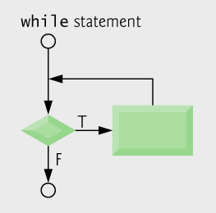
Iteration
while Loop:
    syntax (form):
    while(logical expression) statement

Slide 8
Iteration
    Ex.
    /*comment to describe what loop does*/
    scanf("%c", &ch); /*prime read*/
    while(ch == ' ') scanf("%c", &ch);
    Note: while loops use pretesting. The logical expression is evaluated to true or false to determine whether or not the loop body is executed.

Slide 9
Iteration
Notice the syntax:
    The logical expression is contained in parentheses.
    There is no semi-colon after the expression.
    there is only one statement executed if the expression is true; that one statement may be a compound statement { }.

Slide 10
Iteration
    Ex.
    /*include a comment to describe what loop does*/
    while(logical expression) {
    statement 1;
    statement 2;
    ...
    statement n;
    }

Slide 11
Iteration
    Ex. Often we must "prime" the loop, such as with an initial or prime read before the loop head.
    #define SENTINEL -999 ... int number;
        // holds individual input value
        /*read and echo zero or more integers*/
        scanf("%d", &number); // prime read while(number != SENTINEL) {
        printf("%d \n", number);
        scanf("%d", &number);
        }

Slide 12
Iteration
Problem:
    Write a code segment to skip over leading non-alphabetic characters in the input stream.
    /*skip over leading non-alphabetic characters in input*/
    scanf("%c", &ch); // prime read
    while( !(ch >= 'A' && ch <= 'Z' || ch >= 'a' && ch <= 'z') )
    scanf("%c", &ch);

Slide 13
Iteration
    What is (always) the value of ch when the loop terminates?
    Notes: You must alter the loop control variable ( lcv ), during execution of the loop. Below, we get trapped in an infinite loop when the input is negative.
    scanf("%d", &x); // prime read
    while(x<0)
    printf("%d\n", x);

Slide 14
Iteration
    This is an infinite loop because the value of the lcv x is not modified in the body of the loop.
    Thus, the stopping condition x >= 0 may never be met.
    The loop will execute “forever”
    Endless loops are bad!

Slide 15
Iteration
Definition and assignment are performed simultaneously
    Output:
    1
    2
    3
    4
    5
    6
    7
    8
    9
    10
Alter the lcv

Slide 16
Iteration
    Ex.
    int i = j = 1;
    while( i<10 && j<10) {
    printf(“%d x %d = %2d\n“,i,j,i*j);
    i++;
    j+=2;
    }
1 x 1 = 1
2 x 3 = 6
3 x 5 = 15
4 x 7 = 28
5 x 9 = 45

Slide 17
Iteration
EOF--End Of File:
    EOF is a system constant that is defined in stdio.h and is -1 on our system. To enter EOF as input, type control-d a time or two.

Slide 18
Iteration
    Ex. 1
    sum = count = 0;
    while(scanf("%d", &x) != EOF) {
    //add x to the running sum
    sum += x;
    count++;
    //increment the number of //integers read
    }

Slide 19
Iteration
    Notice: there is neither a prime read nor a read in the body of the loop below.
    All input is done in the loop head as part of the test.
    The loop halts when scanf( ) returns EOF.
    Always test for EOF, not -1 or control-d.
    If you what to enter EOF using keyboard, in linux, it is control-d; however, in windows, is control-z.

Slide 20
Iteration
    Ex. 2
    int x, count = 0;
    /*Read, echo, and count integers until EOF*/
    while(scanf("%d", &x) != EOF) {
    // Is there more input data?
    count++;
    printf("%d%2d\n", count,x);
    }

Slide 21
Iteration
    while loops use pre-testing.
    The logical expression is evaluated before the loop body is executed.
    The body of the loop is executed zero or more times.

Slide 22
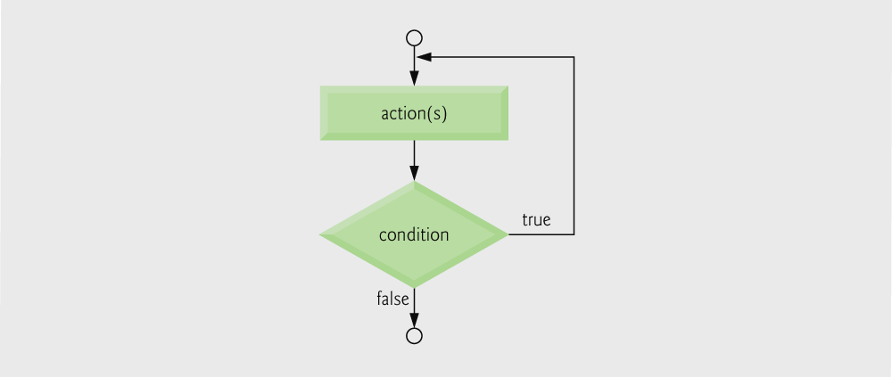
Iteration
do...while Loop:
    syntax:
    do statement while(logical expression)

Slide 23
Iteration
    Ex.
    /*Check for a valid response.*/
    do {
    printf("Continue? (Y or N)");
    scanf("%c", &response);
    } while(response != 'Y' && response != 'N');

Slide 24
Iteration
increments counter then checks if it is less than or equal to 10

Slide 25
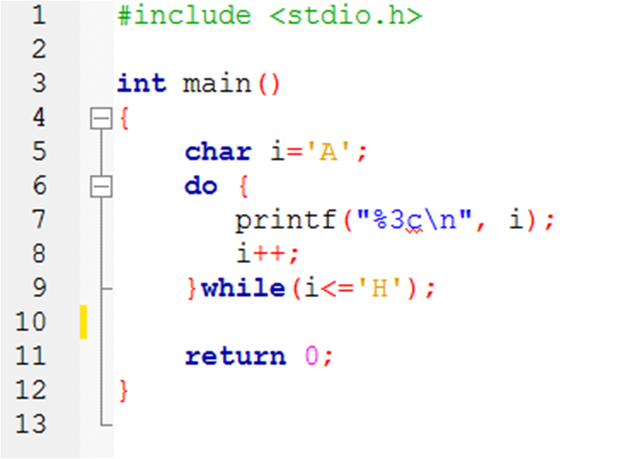
Iteration
    Ex.
Output:
A
B
C
D
E
F
G
H

Slide 26
Iteration
    do...while loops use post-testing.
    The logical expression is evaluated after the loop body has been executed.
    The body of loop is always executed at least once.

Slide 27
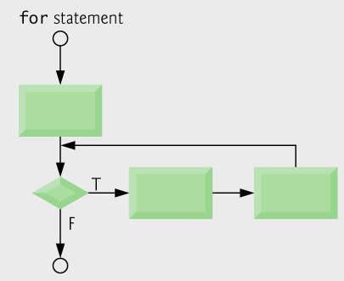
Iteration
for Loop:
    syntax:
    for(expression 1; expression 2; expression 3)
    statement

Slide 28
Iteration
    How for loop works:
        expression 1 is executed once and only once; usually it performs initialization.
        expression 2 is evaluated to either true or false.
        If true, the body of loop is executed; expression 3 is executed; often it updates the lcv; goto step 2.
        If false, exit the loop.

Slide 29
Iteration
    Ex. 1
    for(int counter = 1;
    counter <= 10; counter++ )
    printf( "%d\n", counter );
    //Prints the integers from one to ten

Slide 30
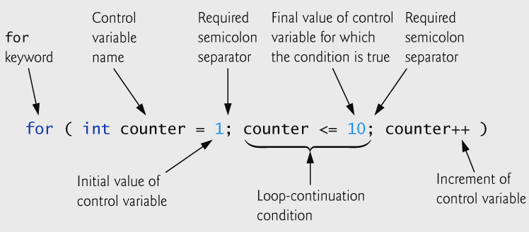
Iteration
    Ex. 1

Slide 31
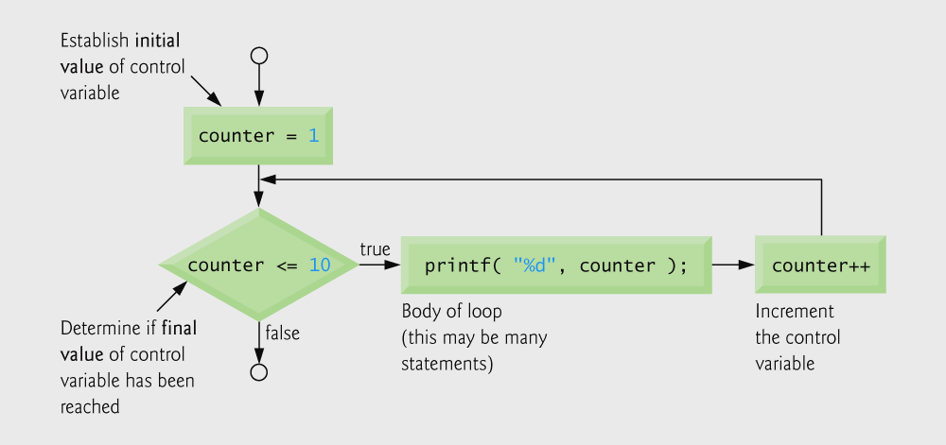
Iteration

Slide 32
Iteration
    Ex. 2 What is output of the following code fragment?
    for(count = 0; count < 4; count++)
    printf("%d ", count);
    printf("\n");
    count: ? output:?

Slide 33
Iteration
    Ex. 3 In a for loop, expression 1 (and expression 3)
    can have multiple parts.
    for(x = 0, y = MAX; x <= N; x++){
    printf("%d ", x + y);
    if( (x + 1) % 5 == 0)
    printf("\n");
    }
    printf("\n");

Slide 34
Iteration
    Ex. 4 Print out every Nth number between 0 and 100, inclusively.
    #define N 10
    for(i = 0; i <= 100; i += N)
    // N is a global constant.
    printf("%d ", i);
    printf("\n");
    How many times is the loop executed?

Slide 35
Iteration
    Ex. 5 Print the numbers from 100 through 1.
    for(i = 100; i >= 1; i--)
    printf("%d \n", i);
    What if expression 2 were i > 1?
    How about i > 0?

Slide 36
Iteration
    What is the difference in the following loop heads?
    What value(s) of N will start execution on the loop? terminate the loop?
    for(i = 0; i < N; i++)
    . . .
    for(i = 0; i < N; ++i)
    . . .

Slide 37
Iteration
    In each one, expression 3 is functionally equivalent to i += 1;
        x = i++; is functionally equivalent to
        x = i; i += 1;
        x = ++i; is functionally equivalent to
        i += 1; x = i;
        Also, we still have i = i + 1; to increment variable i by one.

Slide 38
Iteration
Problem:
    Print out an answer sheet for a multiple choice test with 50 questions, 5 choices per question.
    1. a b c d e
    2. a b c d e
    . . .
    50. a b c d e

Slide 39
Iteration
    We could "hard code" the letter choices, but let's use a nested loop instead.
    /* Print the 50 lines. */
    for(number = 1; number <= 50; number++){
    printf("%2d. ", number);
    /*Within each line, print the letter choices. */
    for(ch ='a'; ch <= 'e'; ch++)
    printf("%c ", ch);
    printf("\n\n");
    }

Slide 40
Iteration
    How many times is each printf( ) statement executed?
        outer loop:
    printf(“%d. ”, number); ___________
    printf(“\n\n”); ___________
        inner loop:
    printf(“%c ”, ch); ____________

Slide 41
Iteration
In general, how many times does the body of a for loop execute?
    The following loop is executed (n-m)+1 times.
    for(i = m; i <= n; i++)
    ...
    The following loop is executed (n-m) times.
    for(i = m; i < n; i++)
    ...
    The following loop is executed (n-m)/x times.
    for(i = m; i < n; i += x)
    ...

Slide 42
Iteration
    Ex. 1 Write code to output the first two columns:
    0 1 2 ^ 0 = 1
    1 2 2 ^ 1 = 2
    2 4 2 ^ 2 = 4
    3 8 2 ^ 3 = 8
    4 16 2 ^ 4 = 16
    5 32 2 ^ 5 = 32
    6 64 2 ^ 6 = 64

Slide 43
Iteration
    The first column is easy: i++
    The second column is 2^. Should we use function pow( )? Not really.
    /*To prevent overflow, i must be <= 30*/
    i = 0;
    power_2 = 1;
    while(i <= 6) {
    printf("%2d %4d\n", i, power_2);
    i++;
    power_2 = power_2 * 2;
    }

Slide 44
Iteration
    OR
    i = 0;
    power_2 = 1;
    while(power_2 <= 64) {
    ... same loop body
    }

Slide 45
Iteration
    OR: Rewrite the while loop as a for loop.
    for(i = 0, power_2 = 1; i <= 6;
    i++, power_2 *= 2) printf("%2d %4d\n", i, power_2);
    How many times is the loop executed?
    (6 - 0) + 1 --> 7
    Why don‘t we need a compound condition with both power_2 and i instead of just i <= 6 ?
    Would the logical expression i < 7 work?

Slide 46
Iteration
    Ex. 2
    Print the number of years it takes for a population to surpass 30,000 in a town whose population grows at a rate of ten per cent annually.

Slide 47
Iteration
    Ex. 2
    year = 0;
    scanf("%d", population);
    while(population <= 30000){
    printf("Year%d:%d\n",year,population);
    year++;
    population *= 1.1;
    }
    printf("It will take %d years.\n", years);

Slide 48
Iteration
    Output if the input is 9870:
    Year 0: 9870
    Year 1: 10857
    .
    .
    .
    Year 11: 28153
    It will take 12 years.

Slide 49
Iteration
    How would you make the population numbers line up nicely in a column?
    Answer: Use %-d or \t in the format.
    What happens if we move the first printf( ) to the bottom of loop?
    Answer: We wouldn't print our original population.

Slide 50
Iteration
    Ex. 3
    sum = count = 0;
    while(scanf("%d",&x)!=EOF&&count<=100){
    sum += x; count++;
    } printf("0.3f\n", (1.0*sum)/count);
    How many times does the loop execute?
    What does the code do?
    What starts the loop?
    What terminates the loop?

Slide 51
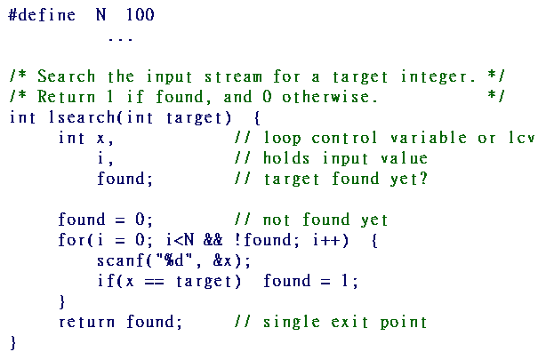
Searching
Linear Search:

Slide 52
Searching
    Note: One exit point makes the code robust and easier to verify.
    /*- -OR- Change loop head; loop still executes N times. -*/
    for(i = 1; i <= N; i++) ...
    What is the value of lcv i when the loop in lsearch() terminates?
    Answer: If the logical expression is (i<N), i equals N ; if it is (i <= N), i equals N+1.

Slide 53
Searching
A lesser Linear Search:
    #define N 100
    int lsearch2(int target) {
    int i, x;
    for(i = 0; i < N; i++) {
    scanf("%d", &x);
    if(x == target) return 1;
    /*-- exit, target found --*/
    }
    return 0; /*exit, target not found*/
    }

Slide 54
Searching
    Ex. What does the following code do?
        int x, y = 0;
        scanf("%d", &x);
        while(x != 0) {
        y = (x % 10) + (y * 10); x /= 10;
        }
        printf("\n%d\n", y);

Slide 55
Converting loops
Nested for Loop :
    /*- format of a for loop -*/
    for(expression_1;expression_2;expression_3) {
    /*- format of a for loop -*/
    for(expression_1;expression_2;expression_3){
    /*- format of a for loop -*/
    ……
    }
    }

Slide 56
Converting loops
for Loop To while Loop & Back:
    /*- format of a for loop -*/
    for(expression_1;expression_2;expression_3)
    body of loop
    /*- format of a while loop -*/
    expression_1
    while(expression_2) {
    body of loop
    expression_3
    }
For(i=0;i<10;i++)
printf(“%d\n”,i);
i=0;
While(i<10){
printf(“%d\n”,i);
i++;
}

Slide 57
Converting loops
do...while To while:
    do{
    body of loop
    expression_3
    } while(expression_2);
    while(expression_2) {
    body of loop
    expression_3
    }

Slide 58
Converting loops
while To do...while
    while(expression_2){
    body of loop
    expression_3
    }
    do {
    body of loop
    expression_3
    } while(expression_2);

Slide 59
Which Loop Should You Use?
while:
    A conditional loop that often doesn't involve counting.
    The body of the loop executes zero or more times.
    Uses pre-testing of the loop control variable(s).

Slide 60
Which Loop Should You Use?
do...while:
    Similar to the while loop except it always executes at least once.
    Uses post-testing of the loop control variable(s).
    Generally used with interactive input.

Slide 61
Which Loop Should You Use?
for:
    A counting loop that may also involve other conditional testing.
    Used extensively with arrays.
    Uses pre-testing of the loop control variable(s).

Slide 62
Which Loop Should You Use?
When Using Loops, Always Ask:
    Under what condition(s) will the loop body be executed?
    Under what condition(s) will the loop terminate?
    What is the value of the loop control variable(s) when the loop halts?
    Sometimes ask, how many times did the loop execute?

Slide 63
break
break
    The break statement provides an early exit from for, while, and do loop, just as from switch.
    The break causes the innermost enclosing loop or switch to be exited immediately.

Slide 64
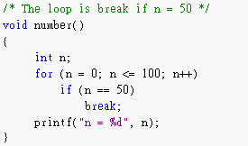
break
    Ex. 1

Slide 65
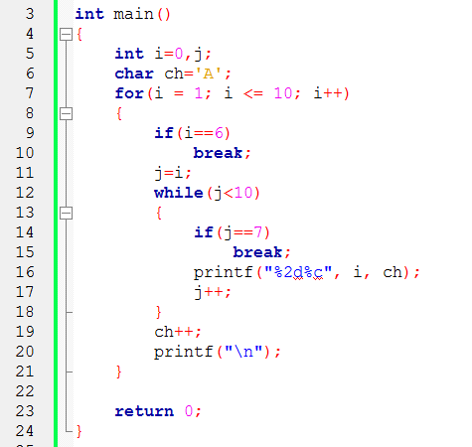
break
    Ex. 2
Output:
1A 1A 1A 1A 1A 1A
2B 2B 2B 2B 2B
3C 3C 3C 3C
4D 4D 4D
5E 5E

Slide 66
continue
continue
    The continue statement causes the next iteration of the enclosing for, while, or do loop to begin.
    In the while and do, the test part is executed immediately.
    In the for, control passes to the increment step.
    It applies only to loops, not to switch.

Slide 67
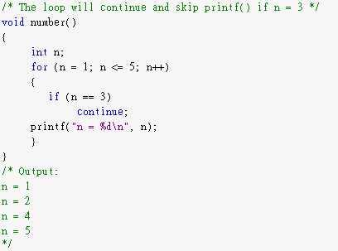
continue
    Ex.

Slide 68
The variable field in loop
Variable field
    Sometimes you will define some variable in main function, even in some loop.
    However, the variable you define in loop can not be used outside the loop.

Slide 69
The variable field in loop
    EX.
    int main(){
    int i = 9 ;
    for( int j = 1 ; j <= 10 ; ++j ){
    int k = i*j;
    cout << k << ’\n’;
    }
    }
    The field of i: the whole main function.
    The field of j: only in the for loop.
    The field of k: only in one iteration of the loop.

